Slide 1
Move Helpr: App-Based Moving Tool
Spring 2021: CS 5001
Jameson Albers

Slide 2

Project Inspiration
Multiple Domestic and Overseas Moves
Lack of User-Friendly Solutions
Potential for Innovation
Notes:
After the bridge course, you can take your Master’s level courses in any order you’d like. I recommend the

Slide 3

Basic Design Principles
Object Oriented
File Handling
Ease of Use
Incorporate Mobile Technology

Slide 4

Project Scope
End-of-Semester Goal:
Develop Backend Foundation
Final Product Goal:
Hybrid Application
Notes:
Core Course - mandatory

Slide 5
Concepts & Resources Used
Class Material
Variables
Data Structures
Loops
Functions
Classes
Files
External Resources
Images (PIL)
qrcode Module
os Module
webbrowser Module
csv Module
Notes:
Not a core or mandated course but highly recommended.
Prerequisite is the Project Course
Usually taken in your final semester in the program and is presented to an audience of your peers and your faculty upon completion of the Thesis
Highly recommended for anyone who is thinking about conducting research in the future, earning a PhD (eventually), or if you’d like to go deeper into a topic area

Slide 6
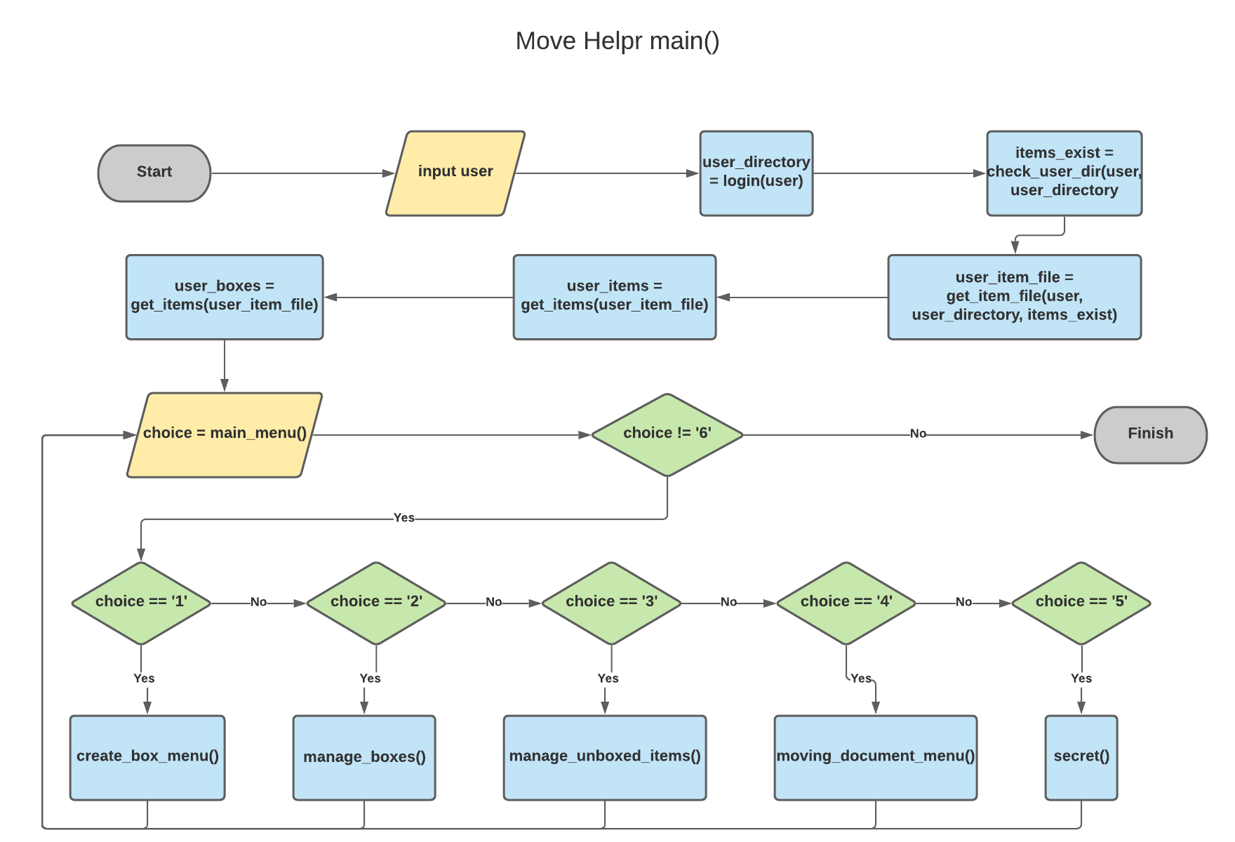
Program Structure
Notes:
Not a core or mandated course but highly recommended.
Prerequisite is the Project Course
Usually taken in your final semester in the program and is presented to an audience of your peers and your faculty upon completion of the Thesis
Highly recommended for anyone who is thinking about conducting research in the future, earning a PhD (eventually), or if you’d like to go deeper into a topic area

Slide 7

Live Demonstration
Notes:
Not a core or mandated course but highly recommended.
Prerequisite is the Project Course
Usually taken in your final semester in the program and is presented to an audience of your peers and your faculty upon completion of the Thesis
Highly recommended for anyone who is thinking about conducting research in the future, earning a PhD (eventually), or if you’d like to go deeper into a topic area

Slide 8
Limitations
Bugs and Unimplemented Features
Limited to MSDOSesque Interface
Stored Locally

Slide 9
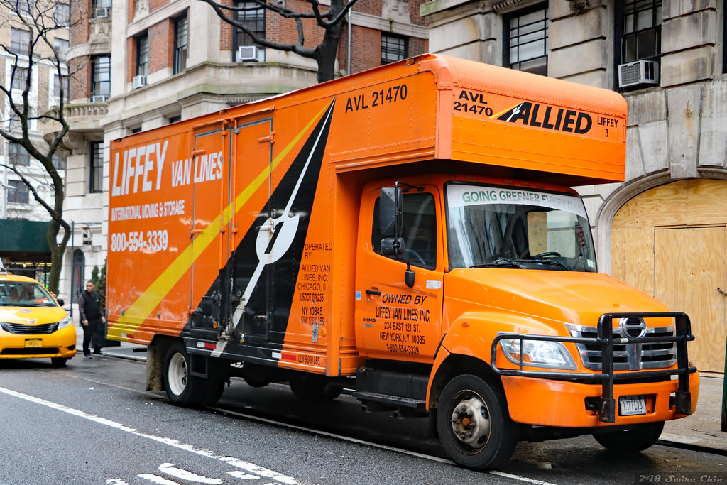
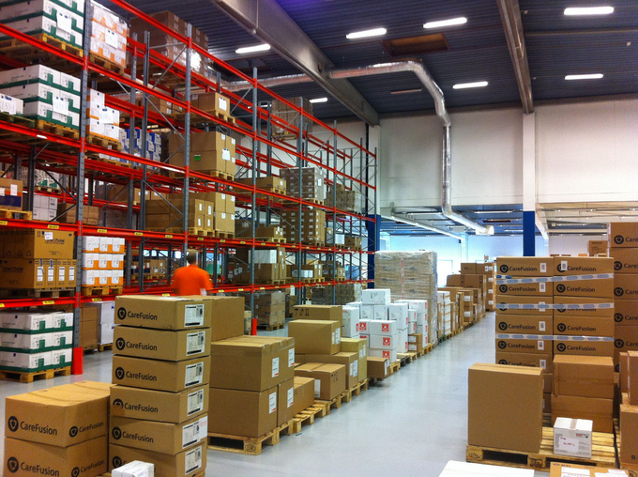
Areas for Further Development
Moving Companies
Logistics & Inventory

Slide 10
Questions?
Jameson Albers
albers.j@northeastern.edu
GitHub:
https://github.com/jlalbers/neu5001/move_helpr

